Slide 1

Welcome Dinner + Trivia 2016
nuwit.ccs.neu.edu

Slide 2
Question #1
What does NUWiT stand for?

Slide 3
Question #2
What is the oldest Northeastern building?

Slide 4
Question #3
Who is the dean of CCIS?

Slide 5
Question #4
Name 7 programming languages

Slide 6
Question #5
Name the world’s first computer programmer.

Slide 7
Question #6
Who founded Grace Hopper Celebration?

Slide 8
Question #7
What languages are these functions written in?
public class HelloWorld { public static void main(String[] args) { // Prints "Hello, World" to the terminal window. System.out.println("Hello, World"); } }
print("Hello world!")

Slide 9
Question #8
What does GUI stand for?

Slide 10
Question #9
What is the difference between RAM and ROM?

Slide 11
Question #10
Who found the first bug in a computer?

Slide 12
Question #11
Fill in the blank:
The brain of any computer system is the ___

Slide 13
Question #12
What year was Northeastern University College of Computer and Information Science founded?

Slide 14
Question #13
In 2013, what percent of US programmers were female?

Slide 15
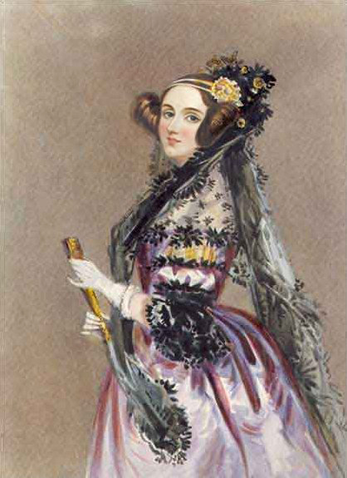
Question #14
Who is she?

Slide 16
Question #15
Who is the associate dean of CCIS?

Slide 17
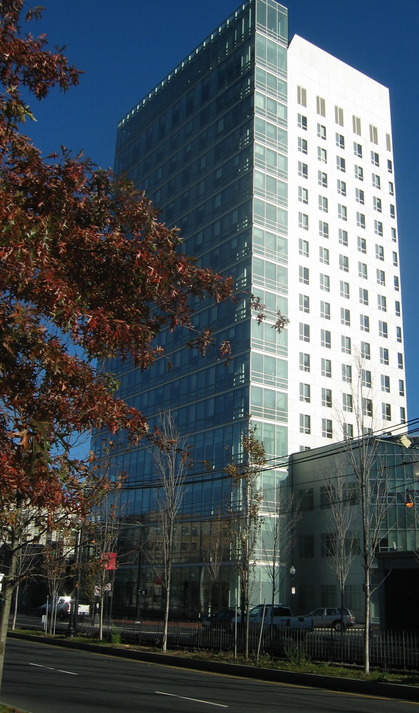
Question #16
Which college of Northeastern University does this building belong to?

Slide 18
Question #17
What year was the internet born?

Slide 19
Question #18
Fill in the blank:
___ is not a primitive type

Slide 20
Question #19
As of 2015, what is Northeastern University’s undergrad population?
(We will accept answers to the closest thousand)

Slide 21
Question #20
Where will NUWiT be holding their meetings this fall?

